Slide 1

An Automated COVID-19 SOPs Monitoring And Management System
GSN: FALL 21-18
Presented by:
Maaheen Yasin (L18-1267)
Inbisat Mudassar Dar (L18-1283)
Ahmad Tameem Kamal (L18-1358)
Advisor: Mr. Hamza Yousuf
Client: Dr. Omer Saleem
Evaluation Committee:
Ms. Shazia Haque
Dr. Omer Saleem

Slide 2
Table Of Content
Microcontrollers
Camera
Sensors
Tensorflow implementation
Kaggle Dataset
Neural Network
Training Custom Model

Slide 3

Microcontrollers: Arduino
Project Scope: Exclusions
TYPE | ARDUINO UNO | ARDUINO MEGA | arduino nano
MEMORY | 2KB | 256KB | 32KB
PROCESSOR | ATmega328 | ATmega2560 | ATmega328
operating voltage | 3.3-5V | 5v | 3.3-5V
cpu speed | 16MHz | 16MHz | 16MHz

Slide 4
Microcontrollers: Raspberry Pi
Project Scope: Exclusions
TYPE | RASPBERRY Pi 4 | RASPBERRY Pi 3b+ | RASPBERRY Pi 3b
PROCESSOR | ARM Cortex-A72 | ARM Cortex-A53 | ARM Cortex-A53
NO. OF CORES | QUAD | QUAD | QUAD
CPU SPEED | 1.5GHz | 1.4GHz | 1.2GHZ
MEMORY | 1GB/2GB/4GB/8GB | 1GB | 1GB
GPU (GRAPHICS) | Dual Core VideoCoreIV®1080p60 | Dual Core VideoCoreIV®1080p60 | Dual Core VideoCoreIV®1080p60
POWER INPUT | 5. 1V/ 3A | 5.1V / 2.5A | 5.1V / 2.5A

Slide 5
Camera
TYPE | SPECIFICATIONS
RPi Camera Module v2 | Low noise, cost 8 MP SONY IMX219 image sensor Higher sensitivity Plug and play
MakerFocus Pi 4B Camera | 5 MP sensor Video at 1080p video recording 1080p Automatic switching filter 2 LED spotlight Works with any RPi model
RPi Camera Module v1 | 1080p HD video recording at 30fps 5 MP sensor Still Picture Resolution: 2592 x 1944
USB WebCam (Aluratek AWC02F) | 1080p video recording Plug and play Fast autofocus Easily adjustable (angle wise) Never blurry

Slide 6
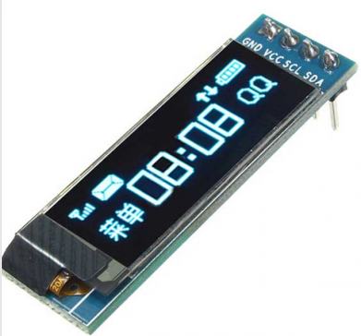

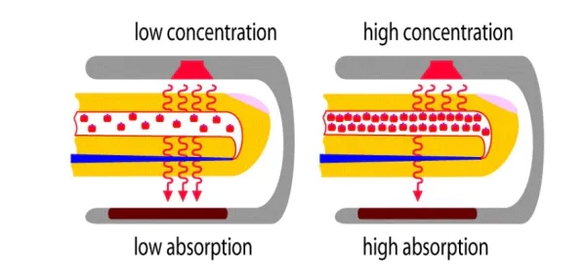
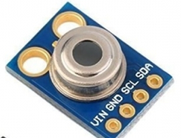

Sensors
TYPE | SPECIFICATION
MAX30102 SpO2 Sensor | LED Peak Wavelength: 660nm/880nm LED Supply Voltage: 3.3~5V Interface: I2C Interface Operating Temperature Range: -40°C to +85°C Dimension: 20.3 x 15.2mm Weight: 1.1g

Slide 7
Tensorflow Implementation
Tensorflow is the Artificial Intelligence library for machine learning used to create neural networks and building custom deep learning models.
We used the google colab to train the neural network model, google colab provide online interface and GPU to train the model.

Slide 8
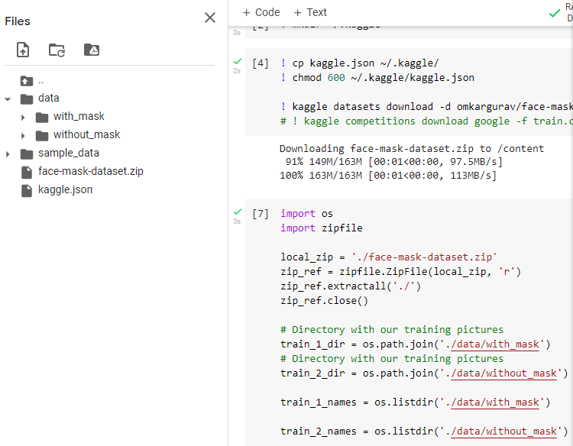
Kaggle DataSet
We used kaggle dataset comprising of 7500 images divided into two categories
The dataset is directly uploaded on google colab, for training deep neural network

Slide 9
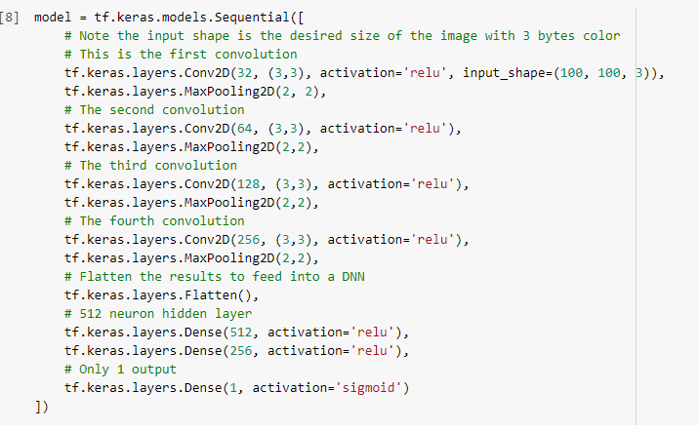
Neural Network Model

Slide 10
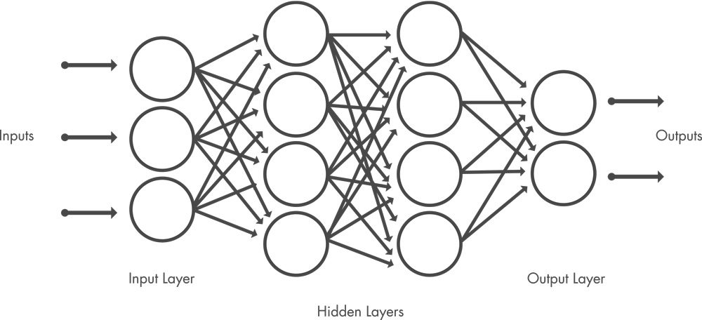
Neural Networks
Convolutions Layers (Extracting features)
Image

Slide 11
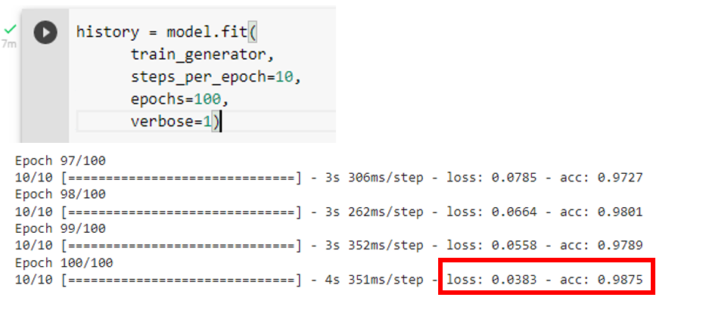
Training Custom Model

Slide 12
Thank You

